Slide 1
Video Pipeline for Computer Vision
sddec24-proj006 V-PIPE
Team members: Liam Janda, Taylor Johnson, Ritwesh Kumar, Deniz Tazegul
Client: JR Spidell
Advisor: Dr. Phillip Jones

Slide 2
Problem Statement
Video pipeline for computer vision system
Off the shelf components/open source software
Wide range of applications
Inspired by improving the quality of life for wheelchair bound individuals with limited mobility

Slide 3
Project Plan

Slide 4
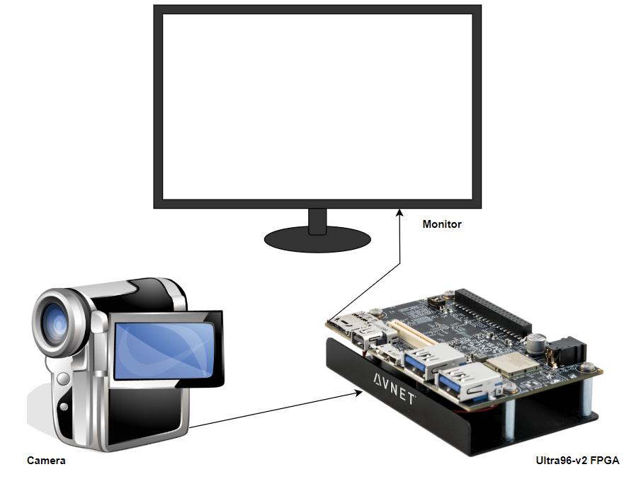
Project Conceptual Sketch
Notes:
Multi-year, multi-team project, Proof-of-concept video pipeline, Off-the-shelf hardware components

Slide 5
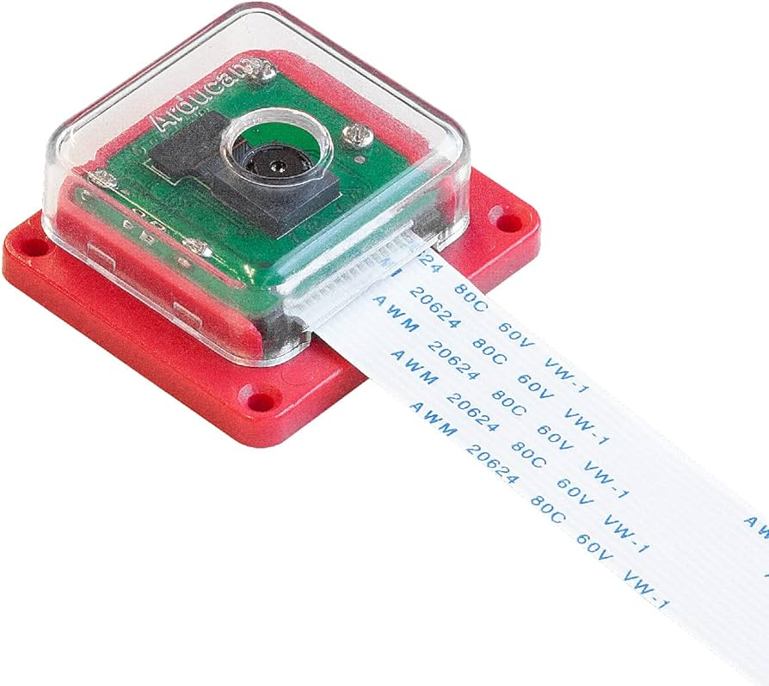
Project Overview
Developing a FPGA-based video pipeline
MIPI-connected camera module
DisplayPort output
Software executes in Ubuntu Linux OS
Adapting previous team’s implementation
PYNQ libraries
STRETCH GOAL: Pass video through a machine learning algorithm
IMX219 Image Sensor

Slide 6
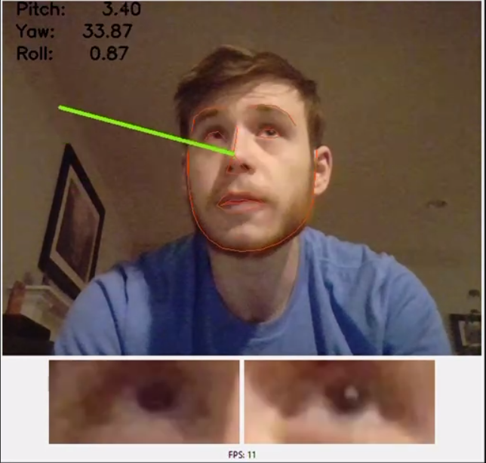
Applications to Machine Learning (ML)
Medical imaging
Self-driving cars
Search and rescue
Eye-tracking devices
Eye-Tracking Algorithm by a Previous SD Team

Slide 7
Market Research
Producer | Pros | Cons
V-PIPE (Ours) | Off-the-shelf hardware | Proper configuration
 | Efficient | Specialized components with longer development time
 | Attachable to existing wheelchairs | Niche market
 | Easily configurable software | Requires own hardware

Slide 8
Requirements
Constraints:
Output video to a DisplayPort monitor in real-time
Route data using a Linux image in a PYNQ environment
Must execute using an Ultra96-v2 FPGA board
Non-Constraints:
Use a Sony IMX219QH5-C image sensor
1920x1080p standard Full HD resolution at 30 fps standard live video format
Video stream in RGB8 color format
Operate in a variety of lighting conditions

Slide 9
Engineering Standards
Engineering Standards | Relevance
IEEE Std 2977 2021 | MIPI controller data conversion
IEEE Std 802.11 2016 | Wifi connectivity: Jupyter Notebook server
I2C Protocol | Data communication with camera
AMBA AXI4 Protocol | Data transport within the FPGA
Notes:
AMBA consists of both the AXI4-Lite bus used to transmit data from the program memory to configure IP registers and the AXI4-Stream bus used to transmit video data between individual IPs within the FPGA including the MIPI controller, VDMA, TPG, and DisplayPort.

Slide 10
System Design

Slide 11
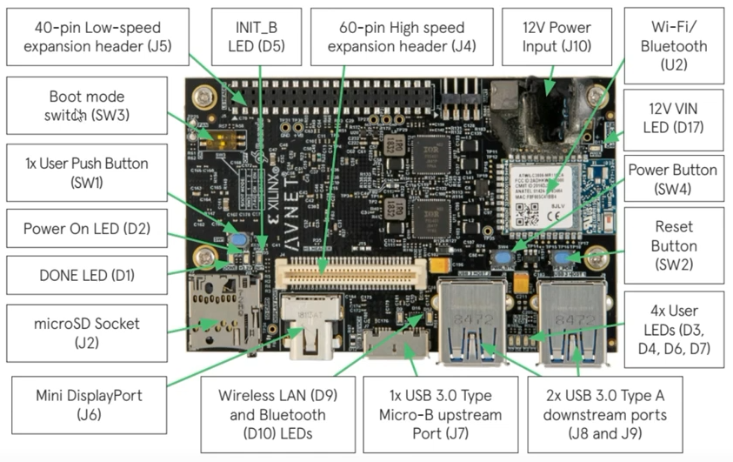
Technology Used
External project complexity
Well-established technology
Ultra96-v2 FPGA made in 2018
IMX219 sensor made in 2016
Internal project complexity
Multiple hardware & software components & subsystems
Anatomy of Ultra96-v2 FPGA

Slide 12
Hardware/Software
PYNQ runs a Jupyter Notebook server
Non-PYNQ runs on a terminal via TeraTerm
Vivado custom hardware overlays
Debug: ILA (Integrated Logic Analyzer) captures and analyzes I/O signals

Slide 13
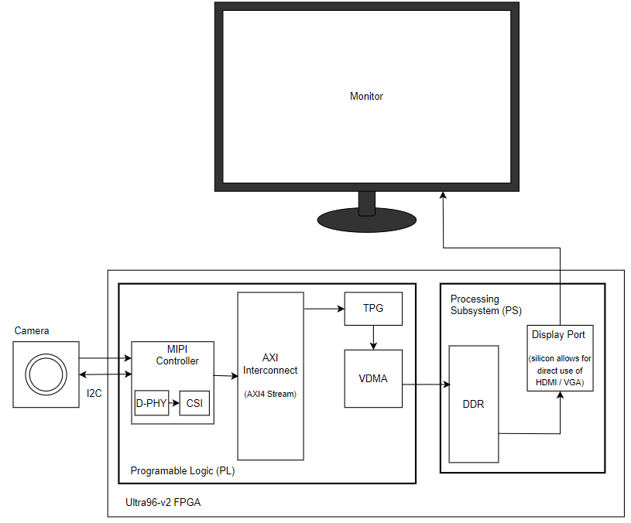
Video Pipeline Block Diagram

Slide 14
Changes from Previous Teams
PYNQ implementation instead of shell scripts or C
IMX219 sensor instead of OV5647
4 data lanes instead of 2
VDMA instead of frame buffer
Notes:
Unit testing will ensure each component is working following our design and requirements.
Integration testing ensures that connecting components are configured correctly to pass data between them.
System testing ensures the overall functionality of the design and project meets the project description and requirements.

Slide 15
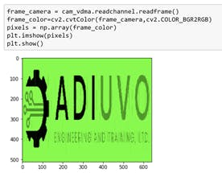
Test Plan
Read from registers with known values
Read from status registers
Visual verification
DisplayPort to monitor
Jupyter Notebook
Acceptance testing

Slide 16
Potential Risks and Mitigation
File/OS corruption mitigation
Backup SD cards
Shutdown Ultra96 using terminal
Proper handling and storing of hardware

Slide 17
Project Resource/Cost Estimate
Resource / Component | Cost
Budget | $3,000
2 Ultra96-v2 FPGA Boards | 2 * ($300 to $600) = $600 to $1200
IMX219/OV5647 Image Sensors | $10 + $20 = $30
2 SD cards: 1 PYNQ and 1 non-PYNQ | $15 + $20 = $35
(1 DisplayPort Cable + 2 USB Mini-to-USB A Cables + 1 Power Supply) * 2 sets | 2 * ($15 + $10 * 2 + $25) = $120
(JTAG board + Ultra96-v2 Daughter Card) * 2 sets | 2 * ($40 + $125) = $330
Total | $1115 to $1715

Slide 18
Conclusion

Slide 19
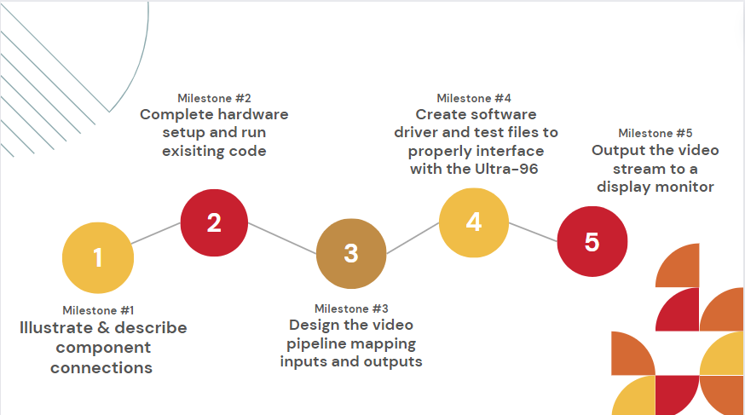
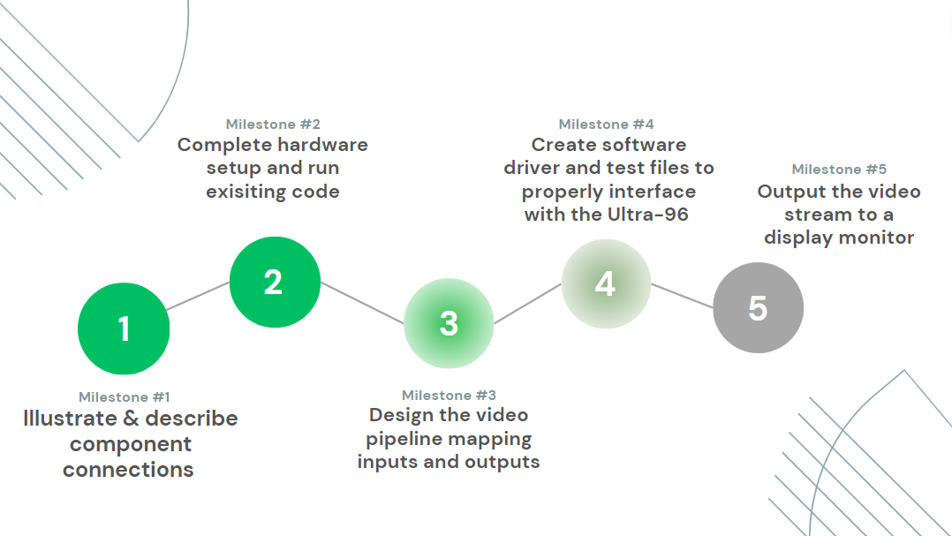
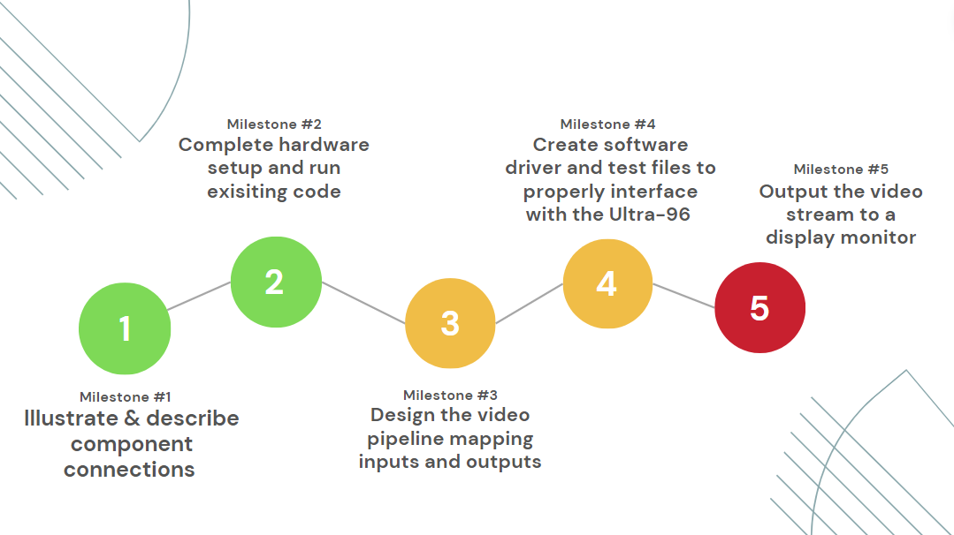
Project Milestones

Slide 20
Current Project Status
Developed understanding of architecture and component subsystems
Tracking the inputs/outputs required for each component and the appropriate register values
Setup hardware and run existing code
Writing the code needed to implement our design

Slide 21
Plan For Next Semester
Transfer code to PYNQ environment
Configure image sensor and MIPI component
Configure board to output through DisplayPort
Replace test pattern generator with VDMA to accept image sensor

Slide 22
Team Member Responsibilities
Team Members/Roles:
Ritwesh Kumar - Image Sensor to MIPI Controller
Deniz Tazegul - MIPI Controller to VDMA
Liam Janda - VDMA to DDRM
Taylor Johnson - DDRM to Output Display

Slide 23
Questions?

Slide 24
Project Vocabulary
IMX219 image sensor: camera
MIPI: mobile industry processor interface
CSI: camera serial interface
D-PHY: physical communication layer
VDMA: video direct memory access
DDR: double data rate (memory)
FPGA: field programmable gate array
PYNQ: python productivity for Zynq (python embedded systems developers)
Ultra96-v2 FPGA Board
‹#›

Slide 25
Backup Slides

Slide 26
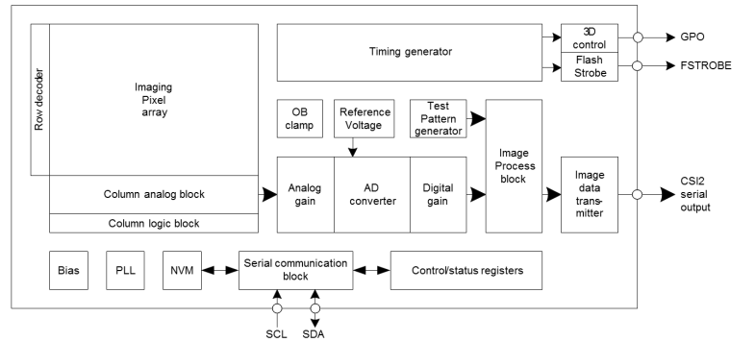
IMX219 Image Sensor

Slide 27
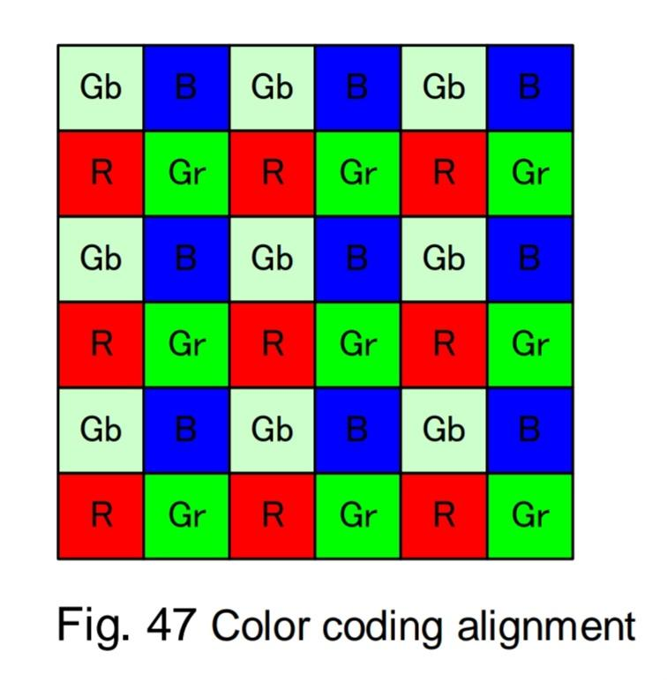
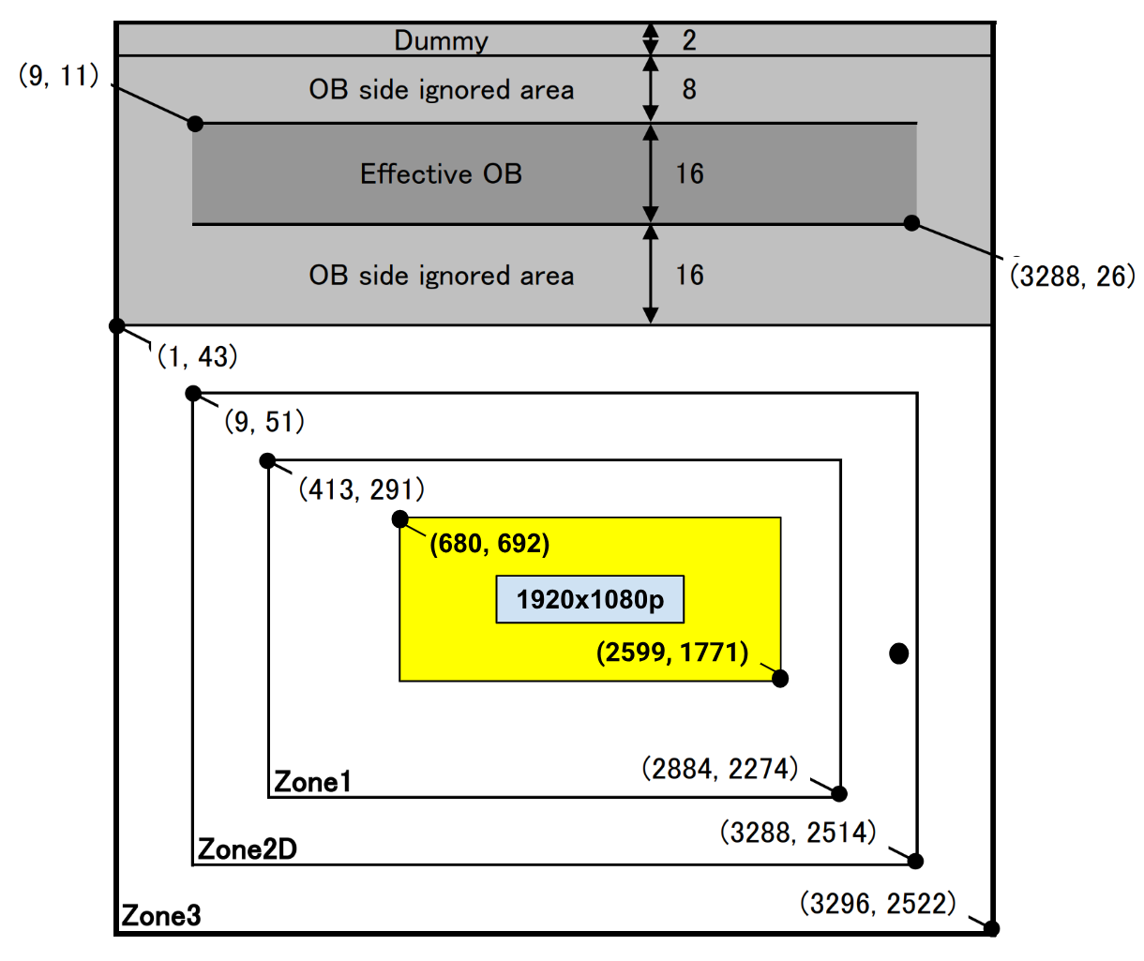
RGB Bayer Filter & 1920x1080p

Slide 28
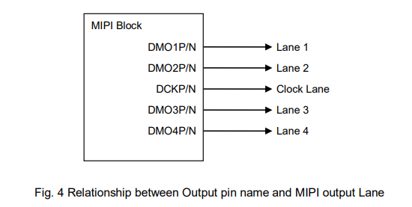
MIPI Transmit

Slide 29
4 Lane MIPI Transmit CSI-2

Slide 30
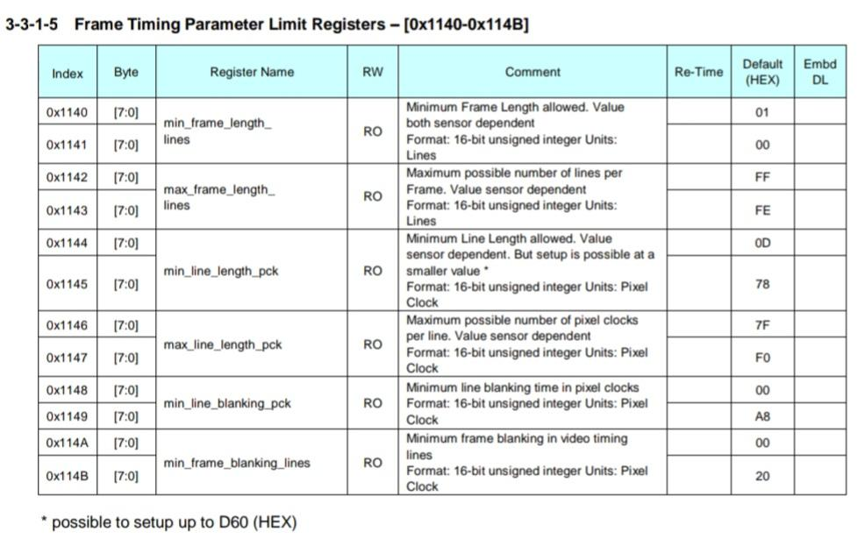
I/O Pixel and I/O System Clock (Code)
Frame length: 256-65,534
1113 in code
Line length: 3448-32752
3448 in code
Min Line blanking: 168 (IMX)
Min Frame blanking: 32 (IMX)

Slide 31
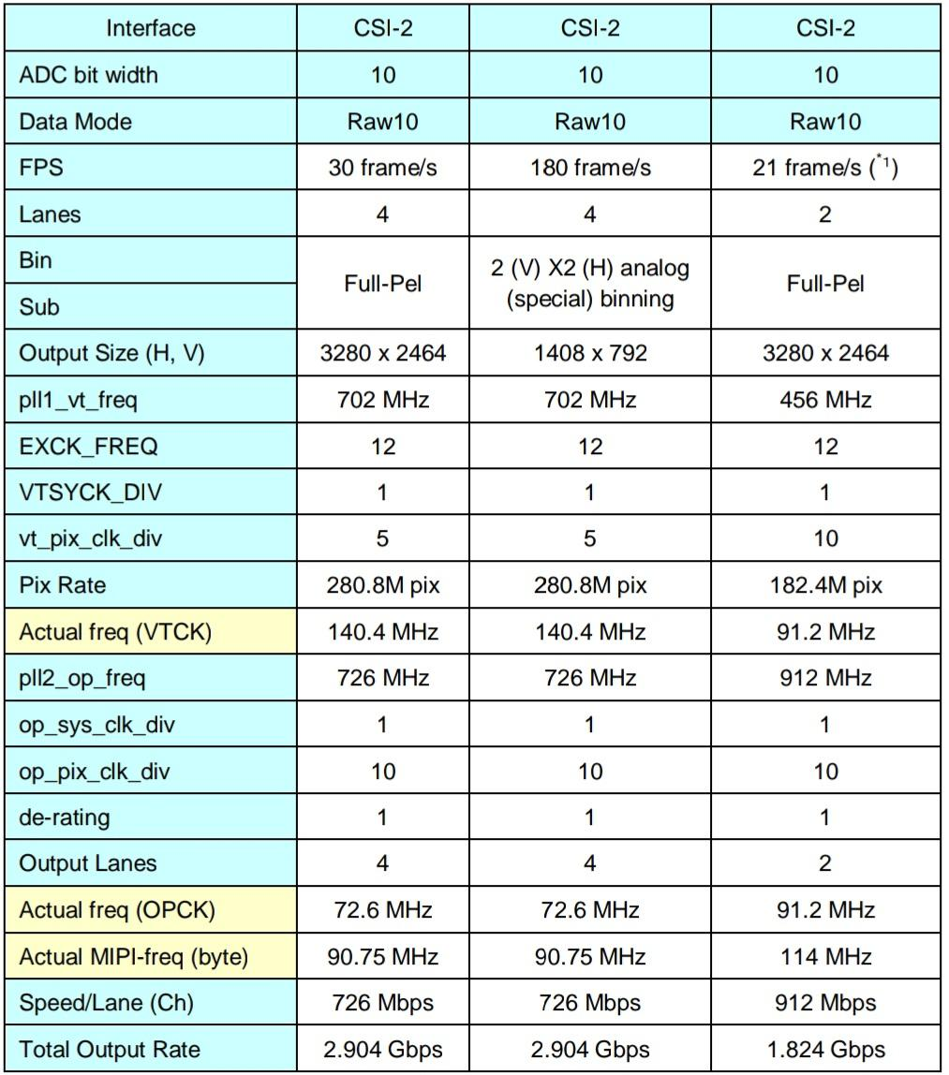
Datasheet Clock Setting Examples

Slide 32
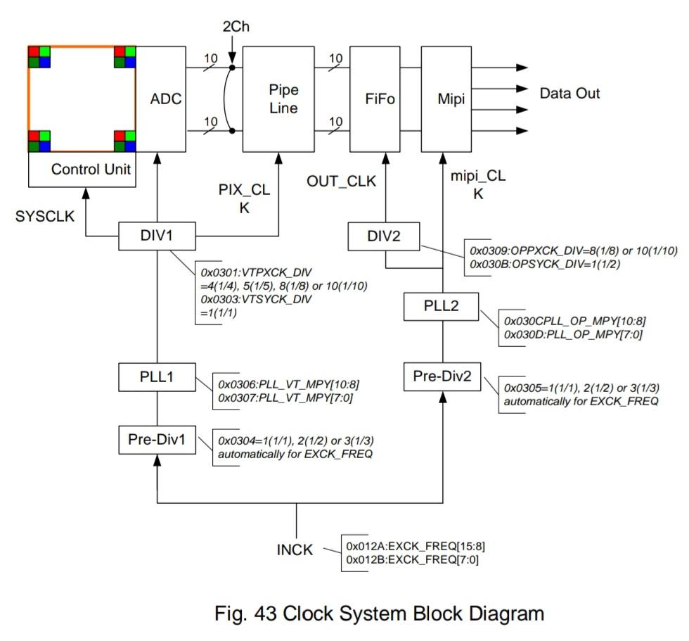
Clock Diagram
Max data transmission = (bits per CSI lane * # of CSI lanes) / Data rate
Data rate = length * height * frame rate * bit pixel depth
Bit pixel depth = bits per pixel * # of channel => RGB = 8 bits * 3 channels = 24
=> (755 Mbps * 4 lanes) / (1920 * 1080 * 24) means that 3.02 Gbps data rate and 60.68 fps are possible for 4 Lane MIPI Tx at 1920x1080p

Slide 33
Frame Rate

Slide 34
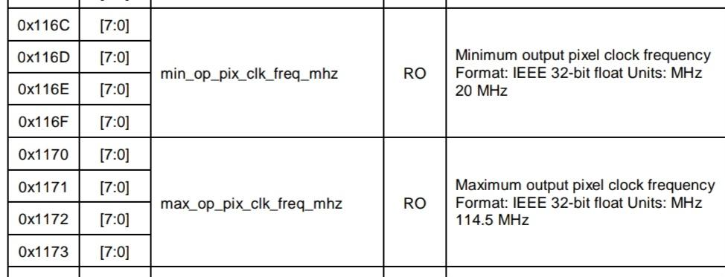
Min/max MIPI-freq

Slide 35
MIPI Freq (Google IMX Driver Code)
Design metric: 30 fps live video industry standard
Frame rate = 47.5 < 60.68 fps limit, frame length = 1113, line length = 3448
Verify
=> Time per line = 1 / (Frame rate * Frame length) = 18915 ns (matches IMX code)
=> MIPI-freq (bytes) = Line length / (2 * Time per line) = 91.15 MHz
Speed = MIPI-freq * 8 * 4 lanes = 2.92 Gbps < 3.02 Gbps 4 Lane max data rate

Slide 36
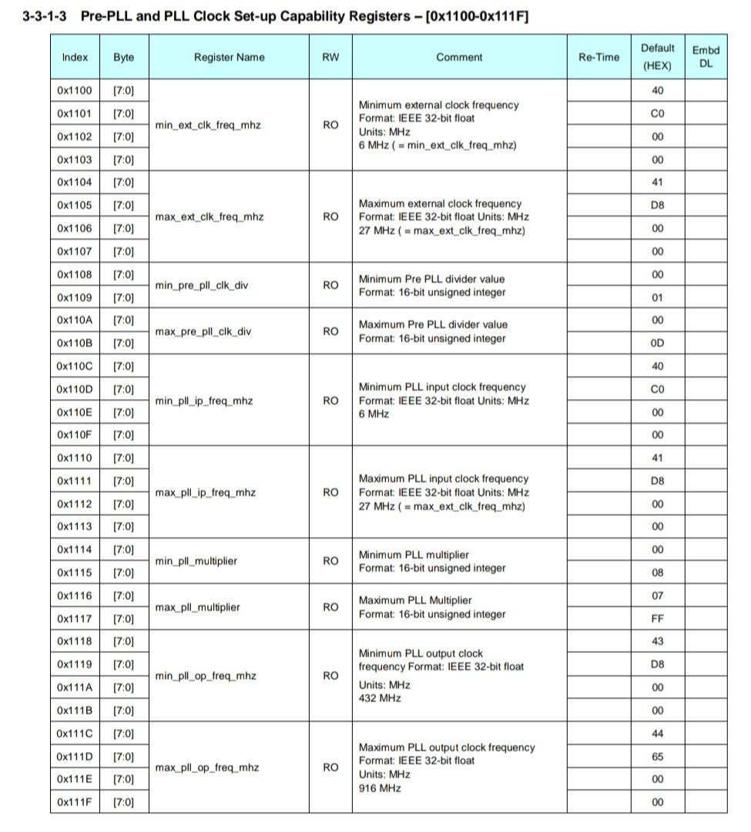
Clock Speeds (Code)
EXCK (external clock) frequency: 6-27 MHz, 24 MHz in code
PLL input clock frequency: 6-27 MHz, 24-27 MHz in code
PLL multiplier: 8-2047, 57 in code for PLL1 and 114 in code for PLL2
PLL output clock frequency: 432-916 MHz
432 Mhz < 729.15 MHz in code < 916 Mhz

Slide 37
Output Freq / PLL2_OP Freq (Code)
Output pixel clock frequency (OPCK) = MIPI-freq (bytes) * 8 / PLL2 multiplier (10 in code)
=> OPCK = 72.915 MHz
=> OPCK is in range: 20 MHz min < 72.915 MHz < 114.5 MHz max
PLL2 Output Clock Frequency (PLL2_OP) = OPCK * PLL2 multiplier (10 in code)
=> PLL2_OP = 729.15 MHz
=> PLL2_OP is in range: 432 Mhz < 729.15 MHz in code < 916 Mhz

Slide 38
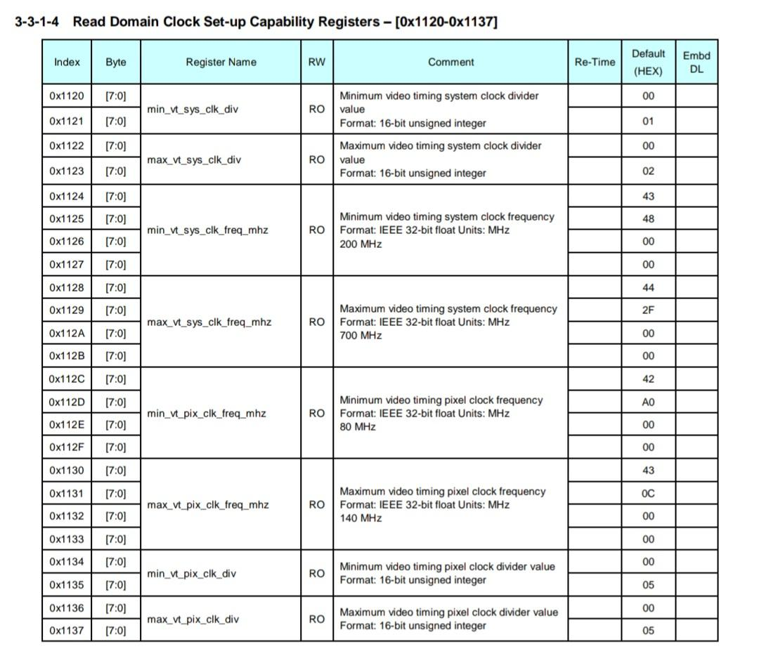
Clock Division Input (Code)
System clock division: 1-2, 1 in code
Video timing system clock frequency: 200-700 MHz, 700 MHz in code
Video timing pixel clock frequency: 80-140 MHz, 140 MHz in code
Video timing pixel clock division: 5, 5 in code

Slide 39
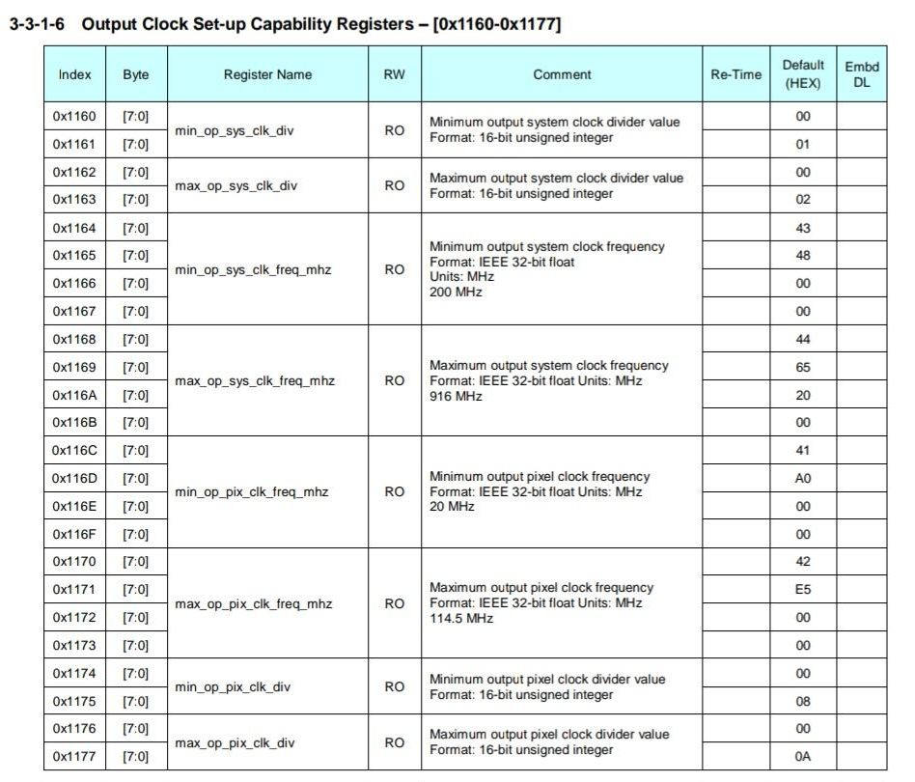
Clock Division Output (Code)
Output system clock division: 1-2, 1 in code
Output system clock frequency: 200-916 MHz, 729.15 MHz in code
Output pixel clock frequency: 20-114.5 MHz, 72.915 MHz in code
Output pixel clock divider: 8-10, 10 in code

Slide 40
Input Freq / PLL1 Freq (in Datasheet)
280 Mbps Pix Rate for 4 Lanes
=> 140 MHz Video Timing Clock Frequency (VTCK) from datasheet
PLL1 Freq = VTCK * PLL1 multiplier (5 in code) = 700 MHz

Slide 41
PLL1 Pix Rate vs PLL2 Data Rate
PLL1 Pix Rate (280 Mbps) < PLL2 Data Rate (2.92 Gbps)
=> “Data is always correctly output from the sensor”

Slide 42
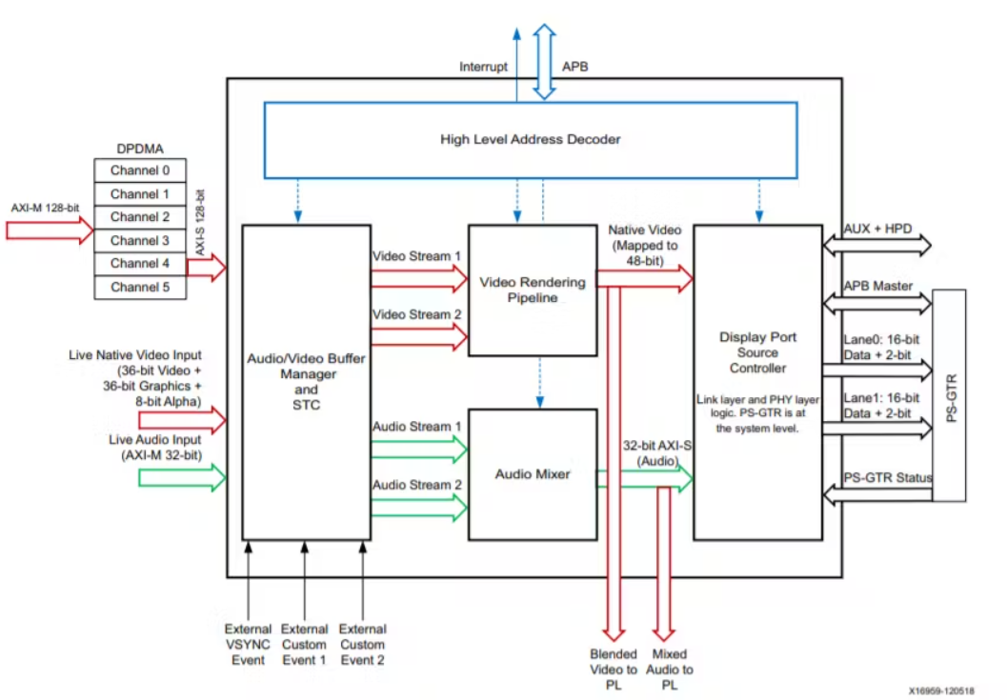
DisplayPort
Notes:
Supports up to 4k resolution @ 30fps, RGB & YUV formats, color depths of 6, 8, 10, 12 bits, native interface so can connect directly to video pipeline w/o any additional processing, silicon display helps convert data packets into appropriate format accordion to video timing standards to output to the display

